Slide 1
Chapter 10: the heart, circulation & blood

Slide 2
AORTA
CARDIAC
CAROTID
CIRCULATION
CORONARY
HEPATIC
HEPATICPORTAL
ILIAC
JUGULAR
MESENTERIC
PULMONARY
RENAL
SUBCLAVIAN
SYSTEMIC
VENACAVA

Slide 3
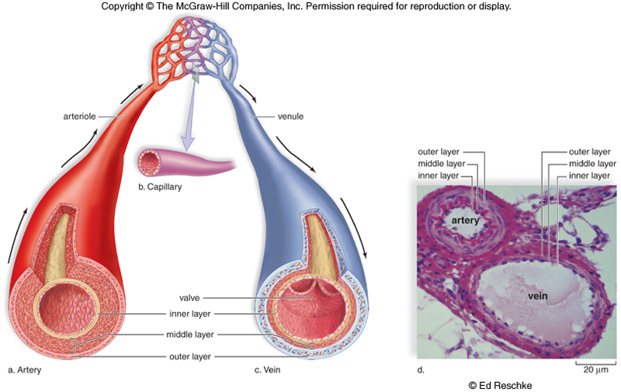
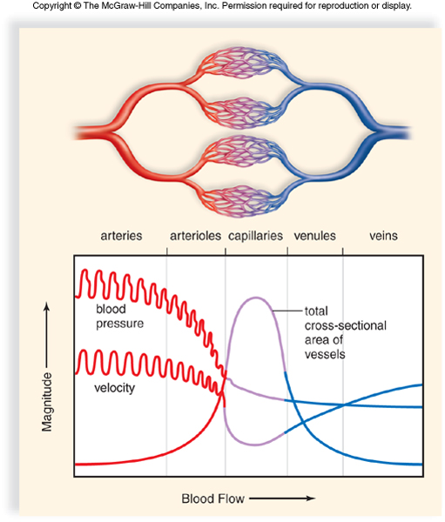
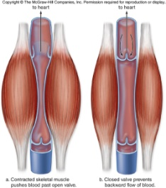
Arteries | Capillaries | Veins
Carries blood AWAY from heart | At tissues for nutrient/waste & gas exchange | Carries blood TOWARDS heart
Thick elastic wall to withstand high BP | Thin wall = 1 cell think to facilitate nutrient/waste & gas exchange | Thin wall due to low BP and with larger lumen to hold more blood
Highest BP | Low BP | Lowest BP
Low Cross-sectional Area | High Cross-sectional Area | Low Cross-sectional Area
High velocity | Low velocity | High velocity
Elastic wall recoils with every heart beat = pulse | Sphincters can constrict to divert blood flow to essential organs | Valve and skeletal muscle contraction help blood flow towards heart

Slide 4
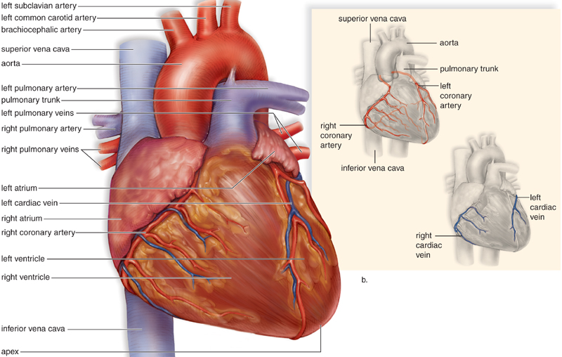

Slide 5
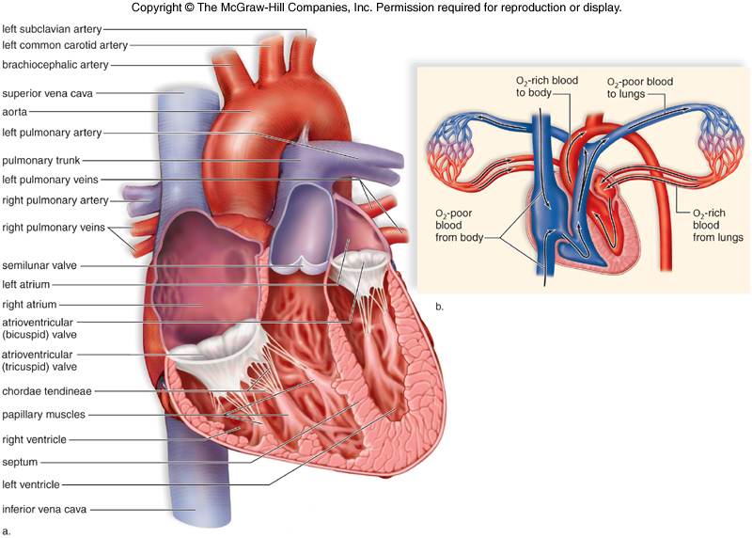

Slide 6
The Heart
Myocardium is a unique muscle that is controlled under the autonomic nervous system – an involuntary division.
The wall of the left ventricle is thicker than the right because the left is pumping a greater distance the entire body while the right pumps to the lungs.
Deoxygenated blood enters the right atrium and from the right ventricle is pumped to the lung where it is oxygenated.
Oxygenated blood enters the left atrium and from the left ventricle is pumped to the rest of the body via the aorta
Atrioventricular valves prevent backflow from the ventricles into the atria – chordae tendenae prevent these valves from inverting.
Semilunar valves prevent backflow from the arteries (pulmonary artery and aorta) into the ventricles.
The coronary artery supplies oxygen and nutrients to the my0cardium and the cardiac vein delivers carbon dioxide and wastes away from the muscles into the right atrium.

Slide 7
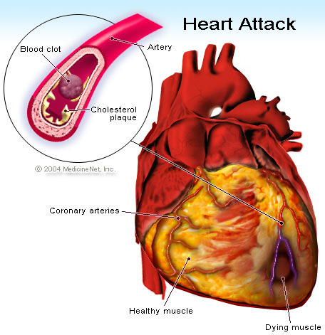
When the coronary artery becomes blocked, the myocardium that receives O2 and nutrients after the blockage will die due to a lack of O2 and nutrients. This is a Heart Attack!

Slide 8
Blood Flow Through the Heart
5
5
6
6
10
1
7
7
4
8
2
9
3
1
1. Superior & Inferior Vena Cava → 2. Right Atrium → Rt. Atrioventricular Valve → 3. Right Ventricle → Pulmonary Semilunar Valve → 4. Pulmonary trunk → 5. Pulmonary Arteries → 6. Pulmonary Capillaries → 7. Pulmonary Veins → 8. Left Atrium → Left Atrioventricular Valve → 9. Left Ventricle → Aortic Semilunar Valve → 10. Aorta

Slide 9
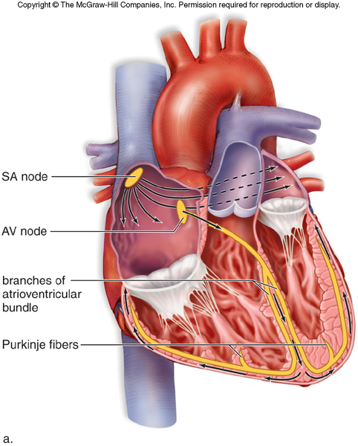
Intrinsic Heartbeat
The SA node sends a signal through the right and left atrium causing them to contract = atrial systole
The AV node receives the signal and sends an impulse through the AV bundle in the septum and the purkinje fibers in the ventricle walls causing them to contract = ventricular systole
The electrical signal dissipates leaving residual electrical activity after contraction during heart diastole
CONDUCTION

Slide 10
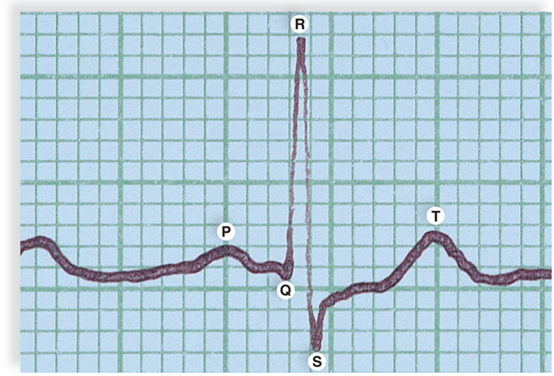
QRS complex occurs just prior to ventricular contraction during the AV node signal through AV bundle in septum and purkinje fibers
T wave occurs after ventricular contraction which represents the detection of residual electrical activity in the heart during diastole
P Wave occurs just prior to atrial contraction during the SA node signal

Slide 11
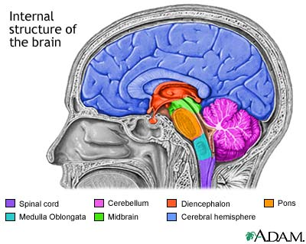
Extrinsic Control of Heartbeat
Medulla Oblongata in the brain sends signals to the SA node of the heart to increase or decrease heart rate depending on the needs of the body.
Sympathetic = fight or flight
Epinephrine is released which increases SA node stimulation and therefore, increases heart rate (& blood velocity)
Parasympathetic = relaxed state
Acetylcholine is released which decreases SA node stimulation and therefore, decreases heart rate (& blood velocity)

Slide 12
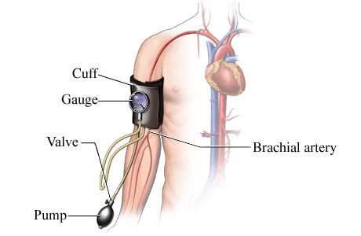
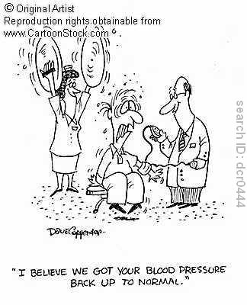
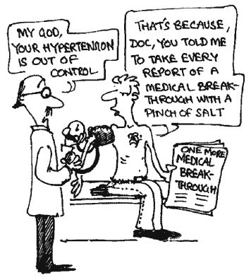
Blood pressure is measures with a sphygmomanometer.
BP in systemic arteries indicates proper functioning of the left ventricle.
Normal BP is about 120/80 mmHg.
120 = systolic BP when the ventricle contracts
80 = diastolic BP when the ventricle relaxes
Hypertension is BP > 120/80
Hypotension is BP < 120/80

Slide 13
When the left ventricle is in systole, there is an increase in pressure in the systemic arteries. This is systolic BP.
When the left ventricle is in diastole, the arteries experience a resting blood pressure. This is diastolic BP.
Pulse is felt in the systemic arteries with every heart beat and can indicate the heart rate and minimum BP.

Slide 14
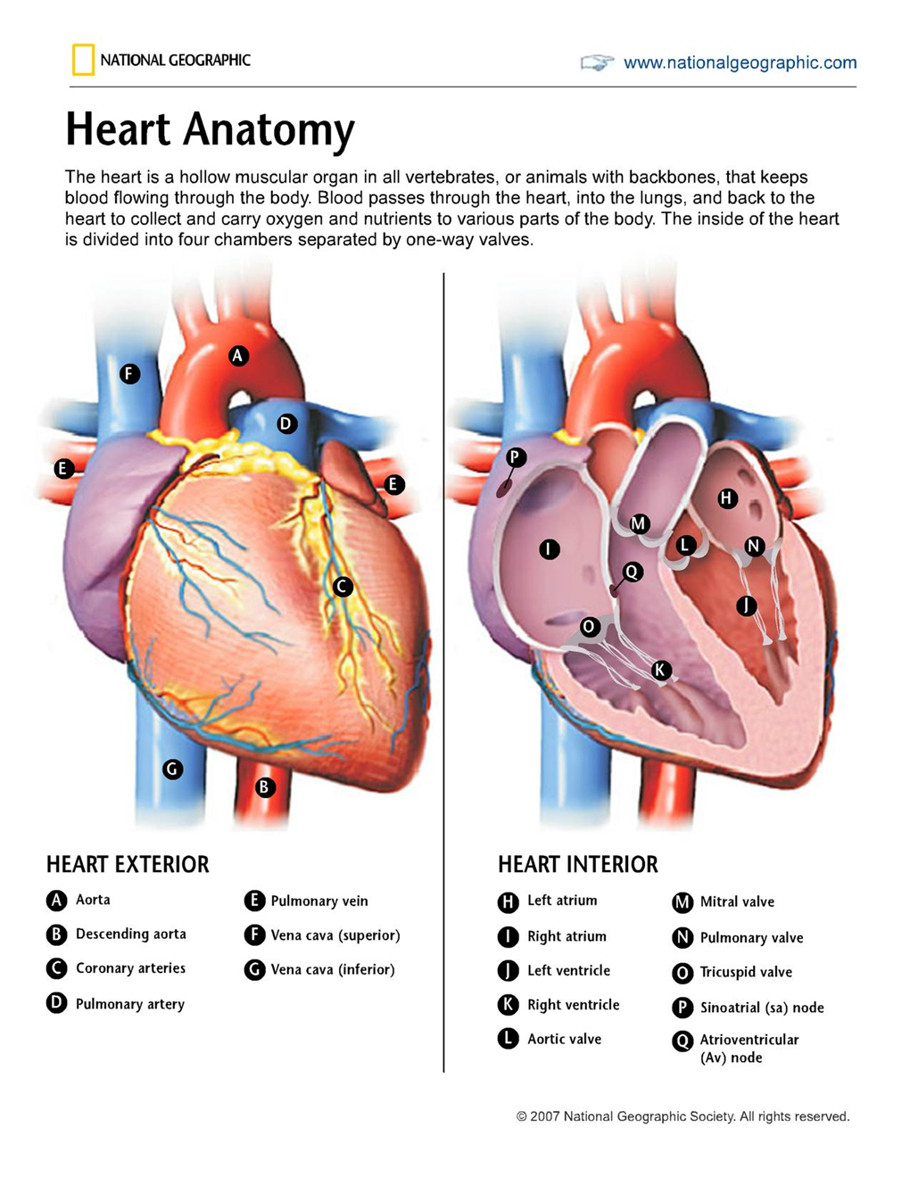
Coronary artery | Aorta
Pulmonary trunk | Pulmonary veins
Inferior vena cava | Superior vena cava
Descending aorta
Left ventricle | Aortic semilunar valve
SA node | Right atrium
Left atrium | Right ventricle
Left ventricle | AV node
Pulmonary semilunar valve | Right AV valve
Left AV valve

Slide 15
Pulmonary vs. Systemic Circulation
PULMONARY Circulation | SYSTEMIC Circulation
Carries blood to and from Lungs | Carries blood to and from body tissues (except lungs)
Right side of heart through lungs to left side of heart | Left side of heart through body to right side of heart
Arteries carry blood low in O2 and high in CO2 | Arteries carry blood high in O2 and low in CO2
Veins carry blood high in O2 and low in CO2 | Veins carry blood low in O2 and high in CO2

Slide 16
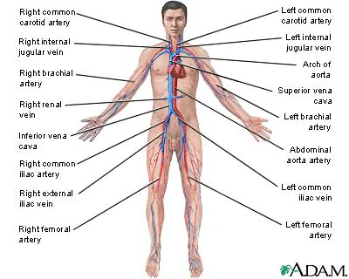

Slide 17
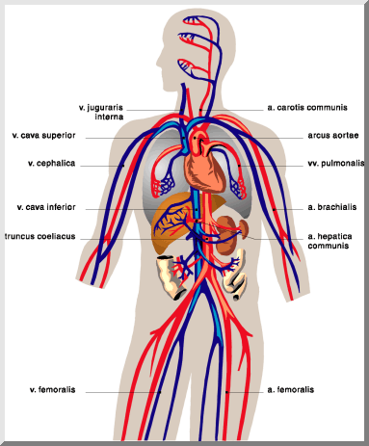
VEINS
ARTERIES
Juglular Vein
Carotid Artery
Subclavian Artery
Subclavian Vein
Aorta
Superior Vena Cava
Pulmonary Vein
Pulmonary Artery
Inferior Vena Cava
Abdominal Aorta
Hepatic Vein
Hepatic Artery
Renal Vein
Renal Artery
Hepatic Portal Vein
Mesenteric Vein
Mesenteric Artery
Iliac Vein
Iliac Artery
Femoral Vein
Femoral Artery

Slide 18
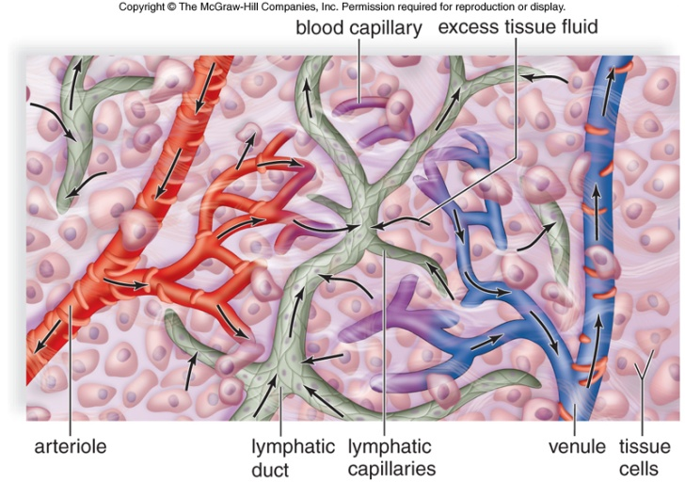
Capillary-Tissue Fluid Exchange
BP higher than osmotic pressure at arterial end; therefore, fluid pushed out of capillary into tissue cells along with nutrients (glucose & aa) and O2.
BP lower than osmotic pressure at venous end; therefore, fluid pushed into capillary along with wastes (urea) and CO2.
Excess fluid in tissues is picked up by lymphatic
capillaries which deliver the fluid to the blood at the
subclavian veins.
http://highered.mcgraw-hill.com/sites/dl/free/0072464631/291136/Fluidexchange.swf

Slide 19
Lymphatic System
Absorbs and returns excess tissue fluid to the bloodstream
Absorbs fats/lipids from the digestive tract & transports them to the bloodstream
Helps defend the body against disease
Lymph contains tissue fluid, bacteria, viruses, old cell parts or debris, antibodies
Lymph fluid moves by skeletal muscle contraction and valves
Lymph is delivered back to blood at the subclavian veins

Slide 20
WBC and Antibody production (T-cells)
Produces RBC,WBC & platelets
Cleanses lymph of bacteria, viruses and cellular debris. Also, WBC and antibody production
Stores & cleanses blood (old RBCs)

Slide 21
Fetal Circulation
1
During fetal development, the organs are developing
Lungs, digestion, and liver are not functional
Due to this, there are 4 main circulatory differences between fetus and adult circulation
2
3
4

Slide 22
Two differences exist that bypass the lungs 1. Arterial Duct (ductus arteriosus) = between pulmonary trunk and aorta 2. Oval Opening (foramen ovale) = between right and left atria

Slide 23
Two differences exist that deliver nutrients & O2 from placenta and take wastes & CO2 to placenta 1. Umbilical cord = 2 arteries carry CO2 & waste to placenta for exchange; 1 vein carries O2 & nutrients from placenta to fetus 2. Venous Duct (ductus venosus) = connects umbilical vein to inferior vena cava and bypasses liver.

Slide 24
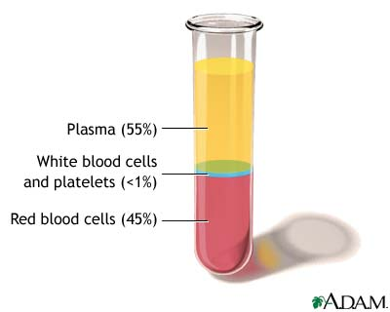
Formed Elements = 45% of blood RBC, WBC, Platelets
Red Blood Cells (RBCs)
Contain hemoglobin
Carry O2 and CO2 throughout body
No nucleus and biconcave shape
Formed in Red Bone marrow

Slide 25
Hemoglobin inside RBCs carry the oxygen, carbon dioxide gases as well as help with buffering at tissues by carrying hydrogen ions. Hemoglobin is a quaternary protein consisting of 4 polypeptides The heme group contains iron and when O2 attaches, blood turns bright red.

Slide 26
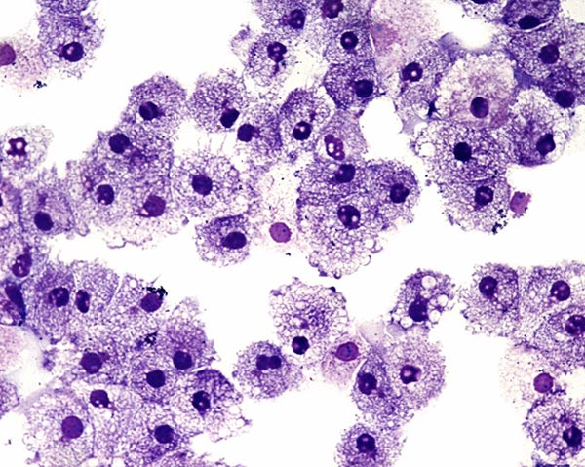
White Blood Cells (WBCs)
Larger than RBCs
Provides immunity by carrying out phagocytosis of antigens and forming antibodies
Contains nucleus (lobed in some)
Formed in Red Bone marrow

Slide 27
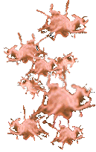
Platelets
Helps to form clots to prevent blood loss
Also involved in formation of clot fibers
No nucleus
Formed in Red Bone marrow

Slide 28
Formed element development in red bone marrow
Agranulocytes
Monocytes

Slide 29
All of the different formed elements
Basophils
Neutrophils
Eosinophils
Lymphocytes
Platelets
Monocytes
Red Blood Cells

Slide 30
Plasma = 55% of blood
Mostly water; ~92% absorbed from colon
Nutrients = glucose, amino acids, lipids from SI
Wastes = nitrogenous wastes like urea & uric acid from liver
Salts from colon
Gases = O2 from lungs and CO2 from tissues
Plasma proteins = albumin & fibrinogen from liver and antibodies from WBCs
Hormones from glands
Vitamins from colon

Slide 31
Blood Typing: Antigens are the RBC surface fingerprints (glycolipids & glycoproteins Antibodies are produced against a foreign antigen (or blood type)

Slide 32
RH

Slide 34
Which structure delivers oxygenated blood to the left atrium? A. N B. B C. J D. D

Slide 35
Which structure delivers deoxygenated blood to the Pulmonary Trunk? A. A B. N C. K D. H

Slide 36
Which cell is responsible for phagocytizing bacteria? A. A B. B C. C
A
B
C

Slide 37
Which cell contains the protein that carries O2? A. A B. B C. C
A
B
C

Slide 38
Which structure supplies the kidneys with O2? A. 1 B. 6 C. 7 D. 15

Slide 39
Which structure would be the vessel where the lymphatic system delivers lymph back to general circulation? A. 1 B. 2 C. 17 D. 10

Slide 40
Which of the following is NOT true? A. The cardiac vein take CO2 and wastes away from the myocardium B. The hepatic portal vein take nutrients from intestine to liver C. The low cross-sectional area of the capillaries causes a low velocity for exchange of molecules D. BP lowers as the blood moves in vessel further from the heart.

Slide 41
Matching blood types
RH
Type AB+
Type A-
Type B+
Type O-

Slide 42
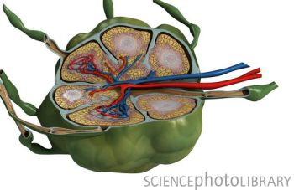
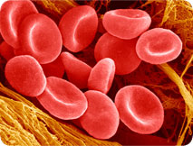
Image | Structure | Function
 |  | Filters bacteria and debris
 |  | Carries Oxygen
 |  | Transports lymph
 |  | Contains hemoglobin
 |  | Engulfs and destroys bacteria
 |  | Engulfs and destroys bacteria
 |  | Helps clot wounds
 |  | Releases histamine
 |  | Causes allergenic response
 |  | Produces antibodies against antigens

