Slide 1
Chapter 11: respiration

Slide 2
Structures of the Respiratory System

Slide 3
1. Nasal cavity has mucosal folds that warm and humidify the air, and cilia that help filter the air. 2. Pharynx is a common passage for air and food. 3. Epiglottis is open to allow air through the glottis 4. Air passes through the vocal cords in the larynx; they are mucosal folds that vibrate to form sounds as air passes
Air passes through trachea to lungs.

Slide 4
5. Trachea is maintained open with cartilage rings and contains mucus producing goblet cells and cilia to sweep mucus and debris away from lungs

Slide 5
6. Trachea divides into two branches called the bronchi (singular = bronchus)
7. Bronchi further branch out throughout the lung into bronchioles
Bronchioles are the smallest passages for air before the air sacs call alveoli
Bronchioles contain smooth muscle which can contract or relax; ex. Asthma occurs when bronchioles contract and swell.

Slide 6
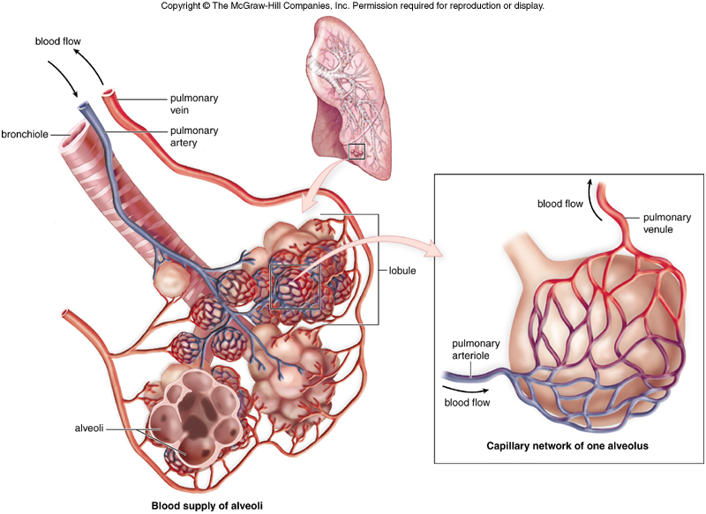
Structure and Function of Alveoli
8. Alveoli are the site of oxygen and carbon dioxide diffusion with blood capillaries.

Slide 7
Inhalation vs. Exhalation

Slide 8
Inhalation vs. Exhalation
The medulla oblongata detects an increase in CO2 and H⁺ in the blood and/or the carotid and aortic bodies detect a decrease in O2 in the blood.
A signal is sent to the intercostal muscles and diaphragm to contract.
The ribs move up and out and the diaphragm flattens/lowers.
The lungs are pulled open due to pleural membranes and a negative pressure is created inside the lungs.
Air is pulled into the lungs for inhalation/inspiration.
The stretch receptors in the alveoli detect overfilling of alveoli.
A signal is sent to the medulla oblongata to stops signals to intercostals and diaphragm.
The intercostal muscles and diaphragm relax.
The ribs move down and in and the diaphragm moves up to dome shape.
There is a positive pressure in the lungs as they are compressed.
Air is pushed out of lungs for exhalation/expiration.

Slide 9
Medulla
Oblongata

Slide 10
External and Internal Respiration
External respiration consists of the reactions that occur in the pulmonary capillaries at the lungs
Internal respiration consists of the reactions that occur in the systemic capillaries at the tissues

Slide 11
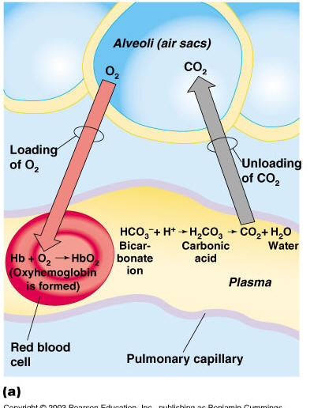
External Respiration
O2 from the alveoli enters the blood capillary due to diffusion
O2 then binds to hemoglobin forming oxyhemoglobin and blood becomes oxygenated and high in HbO2
Hemoglobin has a high affinity for O2 in lungs where it is slightly cool and basic compared to tissues
CO2 was carried in the form of bicarbonate ion (HCO3⁻)
HCO3⁻ is converted to CO2 at the lungs and CO2 diffuses out of the blood and into the alveoli for exhalation
Hemoglobin was also carrying CO2 and H⁺ from the tissues and those are released in the lungs so CO2 is exhaled and hydrogen ion is use in bicarbonate reaction.

Slide 12
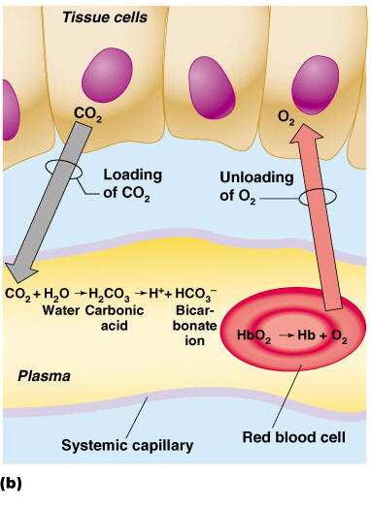
Internal Respiration
Oxyhemoglobin arrives at the tissues.
The blood is slightly warm and acidic here at the tissues compared to the cool and basic lungs so hemoglobin has a low affinity for O2 and O2 detaches to diffuse into tissue cells
CO2 produced by the tissues enters the blood by diffusion and is converted into bicarbonate ion by carbonic anhydrase enzyme.
Hemoglobin also picks up CO2 and H⁺ from the bicarbonate ion reaction to buffer the blood and prevent from becoming acidic.
HHb is called reduced hemoglobin
HbCO2 is called carbominohemoglobin

Slide 13
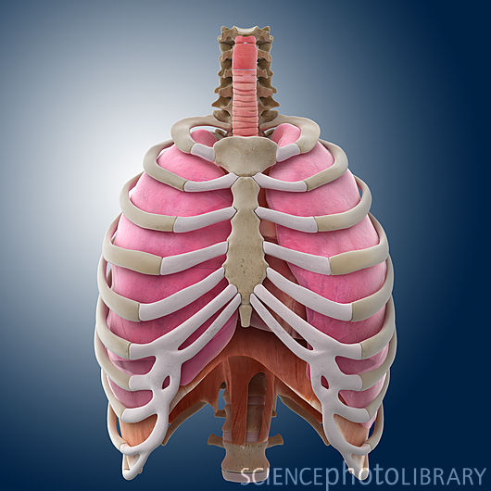

Slide 14
