Slide 1
Chapter 13: Excretion

Slide 2
EXCRETION
Kidneys:
Filter blood of wastes & produces urine
Maintains water & salt balance
Maintains blood pH
Produces hormones
Ureters:
Transports urine from kidney to bladder by peristalsis
Bladder:
Stores urine until urination
Urethra:
Transports urine from bladder out of body during urination
Adrenal glands

Slide 3
Urination = micturition reflex
Bladder fills with urine and stretches.
Stretch receptors send impulse to spinal cord and back as a reflex
Bladder contracts and internal sphincter relaxes
External sphincter is voluntary and you relax it during a convenient time to urinate
http://highered.mcgraw-hill.com/sites/0072495855/student_view0/chapter27/animation__micturition_reflex.html

Slide 4
Kidney Anatomy
Renal Vein: Low in O2, high in CO2, lower than artery but still high in nutrients, LOW in wastes
Renal Artery: High in O2, low in CO2, high in nutrients, HIGH in wastes
Renal Pyramid
Renal Medulla
Renal Cortex
Renal Pelvis
Ureter

Slide 5
Nephrons = kidney tubules for urine formation
The renal artery carries blood high in wastes to the kidney.
Filtration of the blood occurs at the nephron
Wastes are excreted while nutrients are reabsorbed back into the blood
Urine is formed and excreted from the kidney via the renal pelvis into the ureters
Blood leaving the renal vein is low in wastes

Slide 6
Nephron Anatomy & Urine Formation
Pressure Filtration - occurs at the glomerulus where blood is filtered. Only small molecules leave blood (plasma) but large molecules like the formed elements (RBCs, WBCs, platelets) and proteins are not filtered.
Reabsorption – where molecules are reabsorbed from the filtrate inside the tubule back into the blood capillary.
Excretion or Secretion – additional wastes, drugs and hydrogen ions (H+) can be excreted from blood into the nephron tubule to become a part of urine.

Slide 7
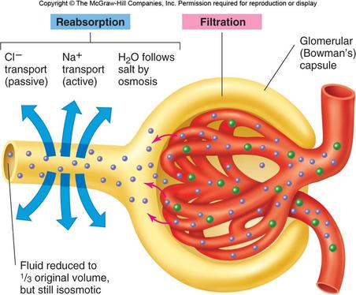
Urine Formation
Afferent Arteriole = high BP to bring wastes to glomerulus
Pressure filtration at glomerulus to push small molecules out of blood (formed elements and proteins not filtered)
Filtrate enters glomerular capsule
At the proximal convoluted tubule reabsorption of nutrients (glucose, amino acids), water, salt – both actively & passively; PCT has microvilli and mitochondria to help with maximal transport of molecules across nephron
Afferent Arteriole
Glomerulus
Efferent Arteriole

Slide 8
Filtrate goes down into the loop of the nephron where it is hypertonic outside the tubule. This causes water to be reabsorbed along the descending limb of the loop
Salt (NaCl or Na+) is reabsorbed along the ascending limb of the loop. This is what causes the medulla to become hypertonic drawing the water out of the tubule by osmosis at the descending limb.
Note: water reabsorption also occurs at the collecting duct due to the hypertonic medulla

Slide 9
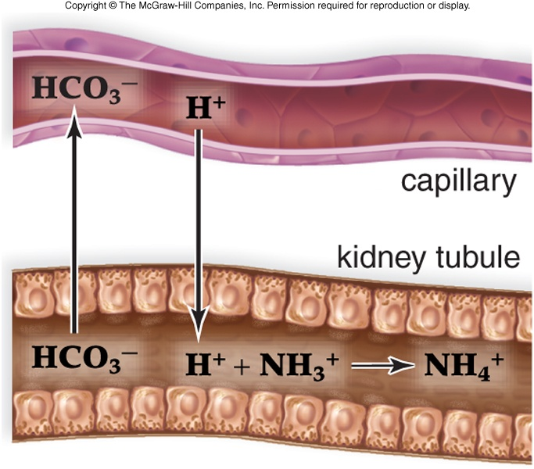
The filtrate travels up into the renal cortex again into the distal convoluted tubule where additional wastes like creatinine is excreted. Also drugs and Hydrogen ions. To maintain pH balance, H+ is excreted and HCO3- is reabsorbed. The H+ is buffered by ammonia in the tubule and urine

Slide 10
The filtrate from many nephrons is now collected by the collecting duct. Since is passes through the renal medulla again, additional water is reabsorbed as it passes through this hypertonic area. This concentrates the urine.
Note: some urea may be reabsorbed due to the concentration gradient.

Slide 11
Summary

Slide 12
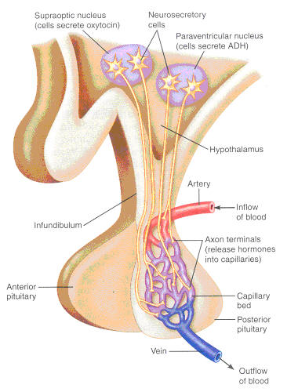
Hormones
During dehydration or low water concentration in the blood, the hypothalamus produces Anti-Diuretic Hormone (ADH).
ADH is secreted out the posterior pituitary gland into the blood to act on the kidney

Slide 13
ADH acts on the collecting ducts of the nephrons to increase water reabsorption
This increases blood volume and water concentration which is detected by the hypothalamus
Negative feedback results and the hypothalamus decreases ADH production
Urine is also more concentrated due to less water content in urine

Slide 14
Aldosterone
When there is low BP due to low blood volume, a specialized group of cells in the kidney called the juxtaglomerular apparatus detects this low BP and secretes renin into the blood

Slide 15
Renin causes the conversion of Angiotensinogen (a plasma protein from the liver) to Angiotensin I
Angiotensin I is converted to Angiotensin II in the lungs
Angiotensin II causes vasoconstriction to increase BP & it acts on the adrenal glands to secrete aldosterone

Slide 16
Aldosterone is secreted from the adrenal cortex
It causes an increase in salt (NaCl or Na+) reabsorption at the nephron
This results in an increase in water reabsorption resulting in an increase in blood volume and blood pressure

Slide 17
Since increased salt reabsorption causes an increasingly hypertonic medulla resulting in an increased water reabsorption along the descending limb and the collecting ducts occurs

Slide 18
Structure/Molecule | Function
Glomerulus/Glomerular Capsule | Site of pressure filtration
Glucose & amino acids | These molecules are completely reabsorbed at the PCT
Collecting Duct (& DCT) | ADH acts here to increase water reabsorption
Descending limb of loop | The part is impermeable to salt reabsorption
Hydrogen ion / H+ | When blood pH is low, there is an increase in excretion of this molecule
Salt/NaCl/Na+ | Reabsorption of this molecule creates a hypertonic medulla
Collecting Duct | The is the last place in the nephron that water is reabsorbed
Adrenal Gland (adrenal cortex is more specific) | Aldosterone is secreted from this gland
Aldosterone | This hormone causes increased salt reabsorption

Slide 19
Structure/Molecule | Function
PCT | Site of glucose reabsorption
Microvilli | Increases surface area for transport of molecules through nephron
Urea & Uric Acid | This waste is filtered out of blood at the glomerulus
Renin | When BP drops, the nephron produces this hormone
DCT | Blood pH is regulated by transport of molecules at this part of the nephron
Water/H2O | This molecule is reabsorbed at the PCT, loop, and collecting duct
Renal Pelvis | This part of the kidney collects all of the urine from the nephrons
Bladder | This structure help to store urine
Ureter(s) | Peristalsis along this tube transports urine to the bladder

Slide 21
Label all molecules with direction of transport in the nephron

Slide 22
A
B
C
D

Slide 23
2
3
A
4
B

Slide 24
 | Function
 | Contains lowest amount of wastes in blood
 | Reabsorption of nutrients
 | Pressure filtration is due to high BP
 | Collects small molecules from blood
 | Water reabsorption and transport of urine to renal pelvis
 | Salt (Na+) reabsorption to make a hypertonic medulla
 | Only permeable to water
 | Acid base balance and drug excretion
 | Delivers blood high in wastes towards kidney
 | Reabsorbed molecules re-enter blood here

