Slide 1
Chapter 2: biological molecules

Slide 2
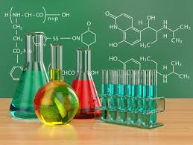
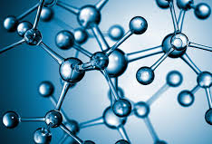
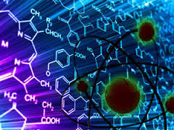
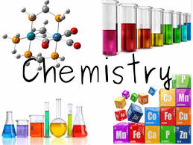
Part 1: Background Chemistry

Slide 3
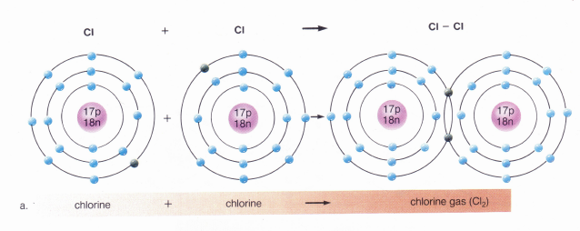
Covalent Reactions
Atoms SHARE electrons

Slide 4
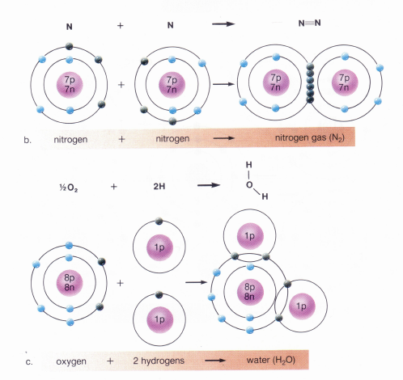
More Covalent Reactions

Slide 5
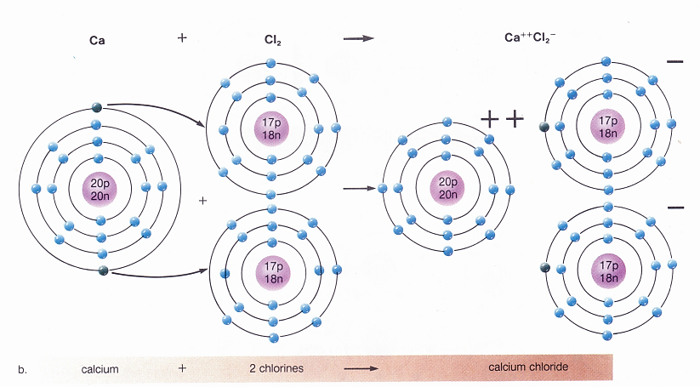
Ionic Reactions
Atoms GAIN or LOSE electrons
Ionic bond= attraction between oppositely charged ions

Slide 6
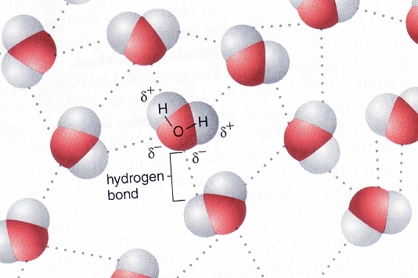
Hydrogen Bonds
Hydrogen bond = covalently bonded hydrogen is positive and attracted to a negatively charged atom
Polarity of H₂0
Hydrogen bonds
Cohesive

Slide 7
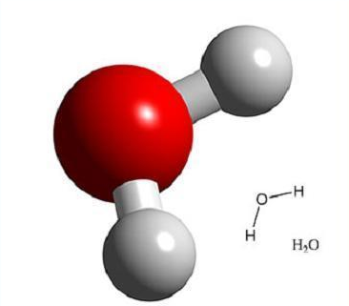
Water
H₂O
Polar = unequal sharing of electron creates opposite charges
  → Hydrogen is slightly positive
  → Oxygen is slightly negative
Properties of Water
  Universal solvent
  Lubricant and cohesive
  Temperature regulator
  Liquid at room temp
  Frozen water less dense than liquid water

Slide 8
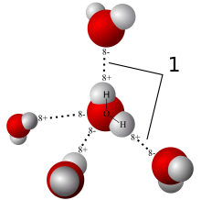
Water
Hydrogen Bonds

Slide 9
pH
H₂O H⁺ + OH⁻ water dissociates
The level of H⁺ compared to OH⁻ helps us to determine the pH of a solution.
If [H⁺ ] > [OH⁻ ] = acidic
If [H⁺ ] < OH⁻ ] = basic
Buffers:
  Bicarbonate ion buffers when too much acidity ( H⁺ )
  H⁺ + HCO₃⁻ H₂CO₃
  Carbonic acid buffers when too much base ( OH⁻ )
  OH⁻ + H₂CO₃ HCO₃⁻ + H₂O

Slide 10
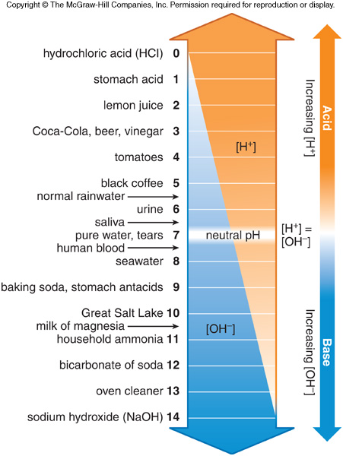
pH Scale

Slide 11
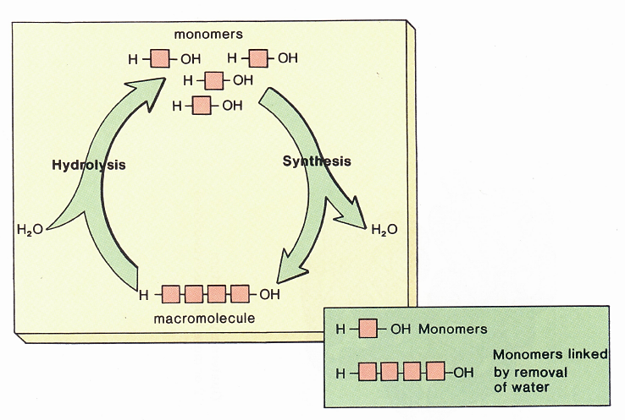
Synthesis (dehydration) & Hydrolysis
Monomer= simple organic molecule, exists individually
Polymer/
Macromolecule= many monomers linked together

Slide 12
Examples of Monomers and Polymers
Polymer | Monomer
carbohydrate | monosaccharide
protein | Amino acids
Nucleic acid | nucleotides
lipids | Fatty acids

Slide 13
Carbohydrates (CH₂O)_{n}
Monomer = glucose
Polymer
  Maltose = dissacharide of 2 glucose monomers
  Starch = stored form of glucose in plants & less branching
  Glycogen = stored form of glucose in animals (liver) & more branching
  Cellulose = =in plant cell walls for structure
Functions
  Short-term energy
  Stored energy
  Cell-to-cell recognition
  Structure in plants and some animals

Slide 14
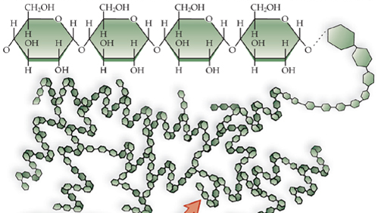
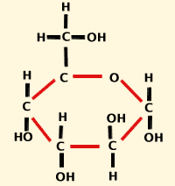
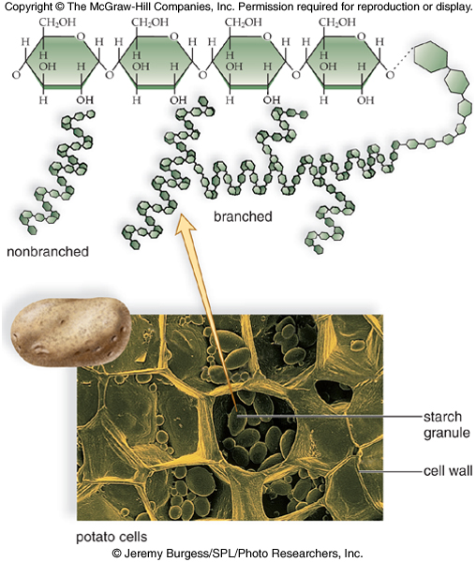
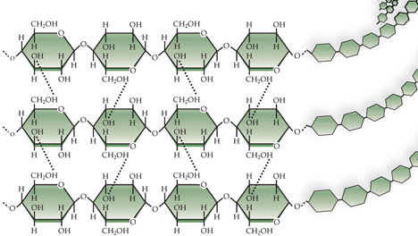
Glucose
Glycogen
Cellulose
Starch

Slide 15
Lipids
Monomer = glycerol and fatty acids
Polymer
  Trigylceride (Neutral Fat) = long-term energy source: ex. Body fat
  Phospholipids = forms plasma membranes and regulated movement of molecules in/out of cell
  Steroids = derived from cholesterol and are chemical messengers: ex. Testosterone, estrogen

Slide 16
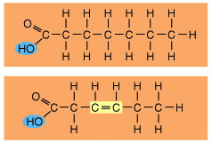
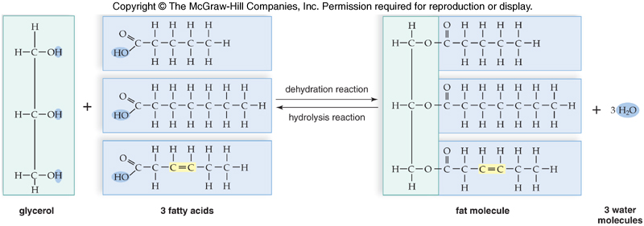
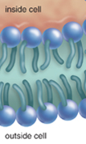
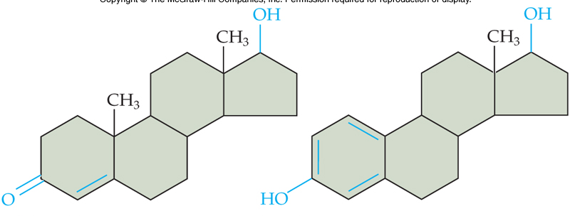
Saturated fatty acid
Unsaturated fatty acid
Hydrophillic (polar)
Hydrophobic (non-polar)
Triglycerides (Neutral Fat)
glycerol
Steroids

Slide 17
Proteins
Monomer = amino acids
Functions
  Transport molecules = through cell membranes and in the blood (oxygen on Hemogblobin)
  Provide structure: ex. Keratin in hair and nails
  Provide movement: ex. Myosin & actin in muscles
  Speed up chemical reactions: ex. Enzymes
  Are chemical messengers: ex. Hormones like insulin
  Allow for cell-to-cell identification
  Help with immunity: ex. Antibodies are proteins

Slide 18
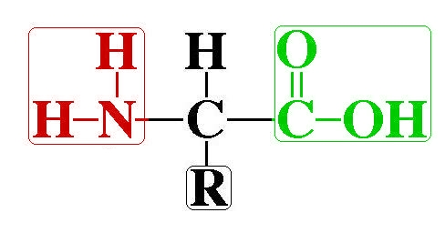
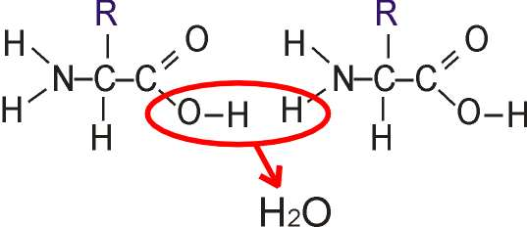
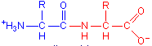
Amino acids
Amine group
Acid (carboxyl) group
Remainder group
Condensation synthesis
dipeptide
Peptide bond

Slide 19
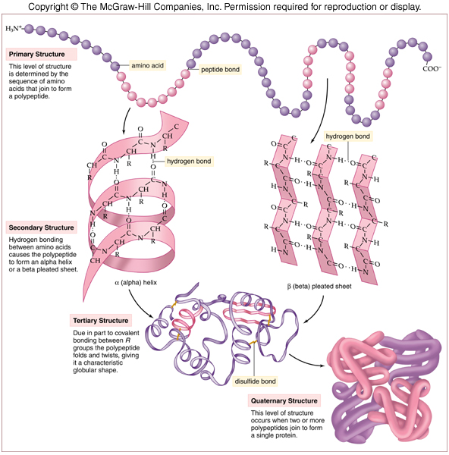
Protein Levels of Structure

Slide 20
Nucleic Acids
Monomer = nucleotides (phosphate group, pentose sugar, nitrogenous base)
Polymers
  DNA (Deoxyribonucleic Acid)
  RNA (Ribonucleic Acid)
  ATP (Adenosine Triphosphate)
Functions
  Replication, cell division, directing cell functions, gene expression for protein synthesis, mutations
  Protein synthesis
  Energy for cell functions

Slide 21
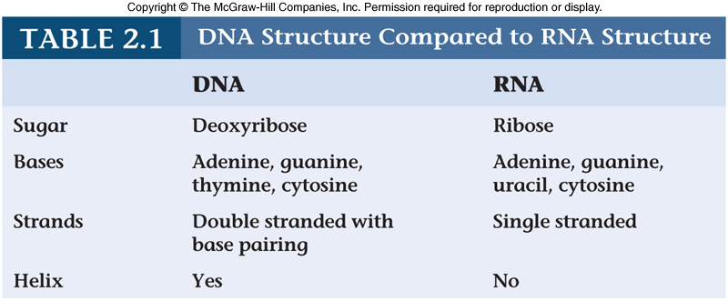
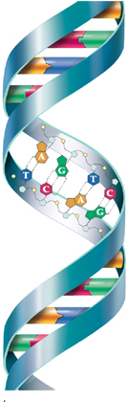
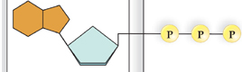
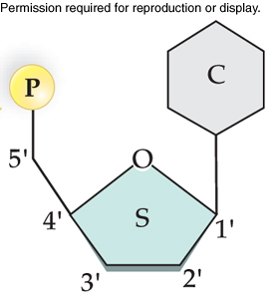
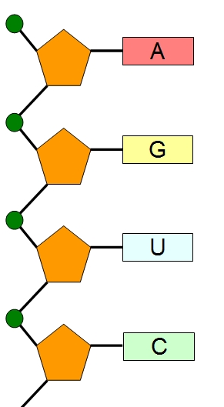
Draw a line to match name to image
Nucleotide
RNA
ATP
DNA

Slide 22
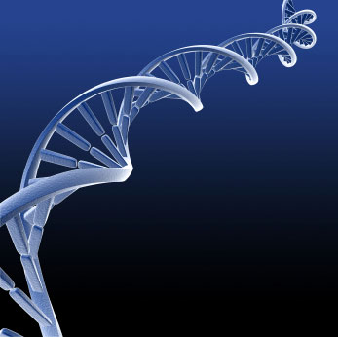
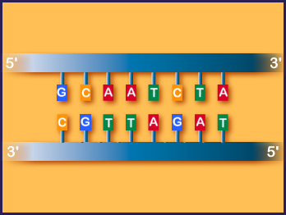
Complimentary Base Pairing
Adenine pairs with Thymine with 2 hydrogen bonds
Guanine pairs with Cytosine with 3 hydrogen bonds
Adenine and Guanine are purine bases with a double ring structure
Thymine and Cytosine are pyrimidine bases with single ring structure
Write the complimentary strand to the DNA strand given below.

Slide 23
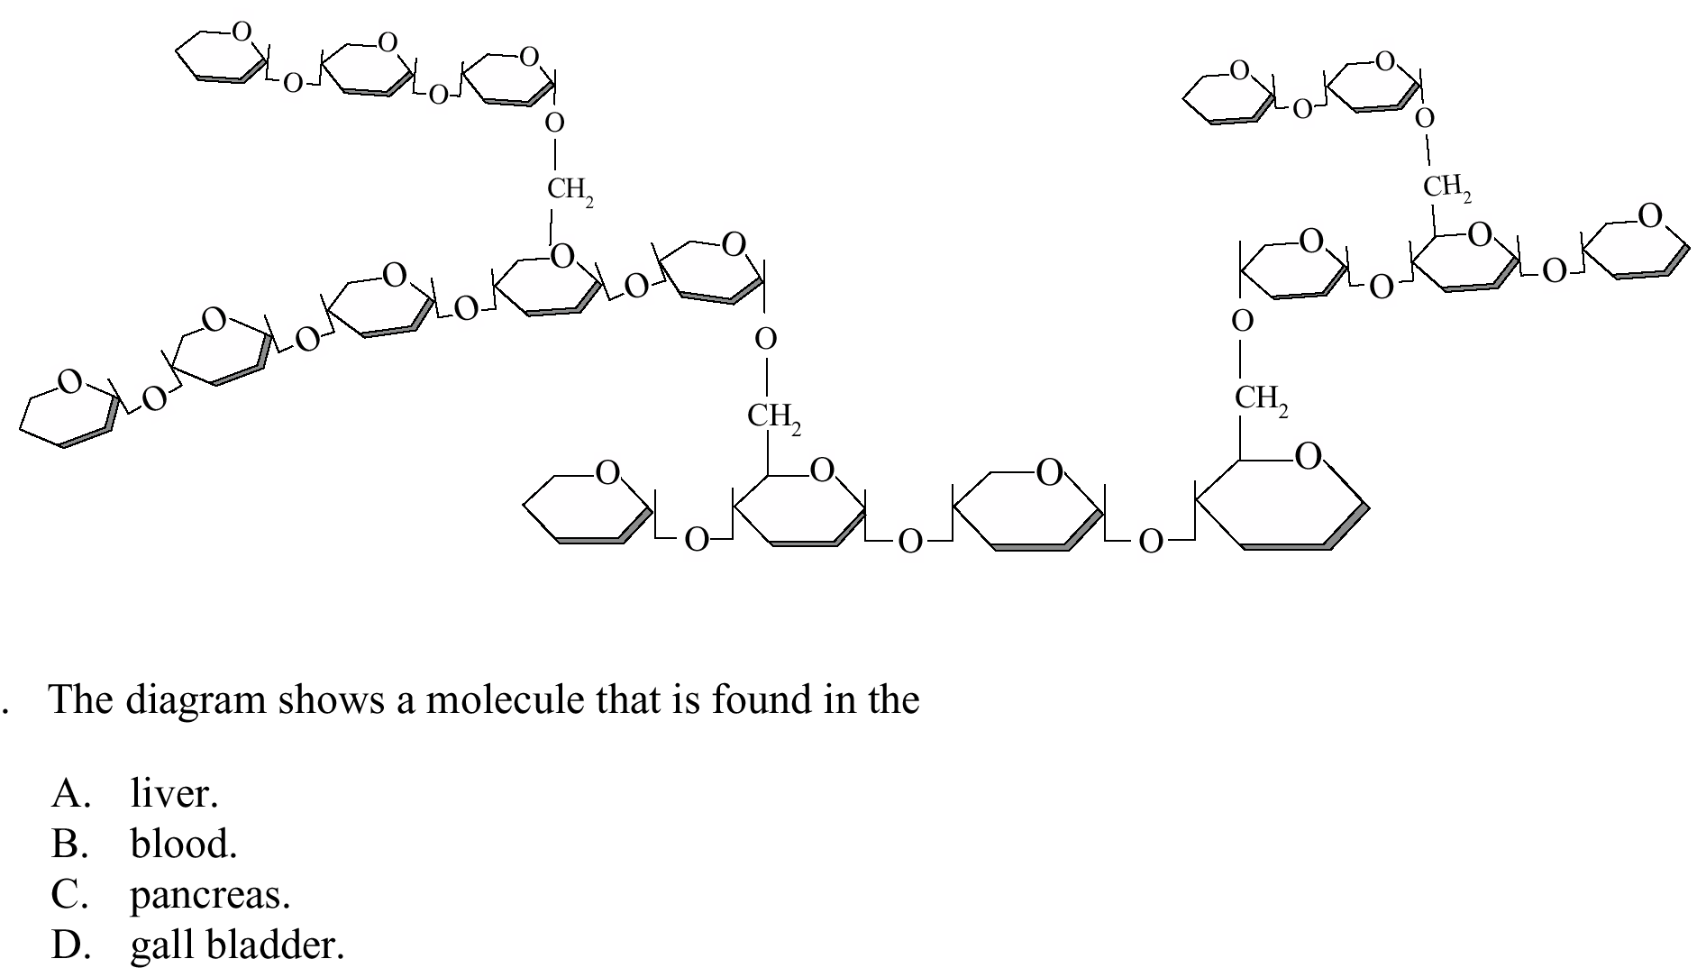
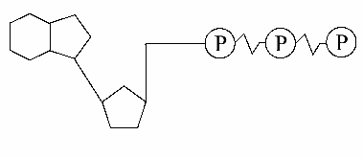
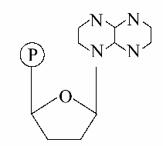
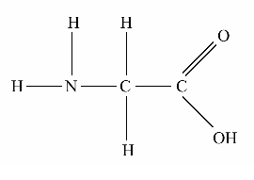
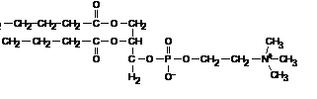
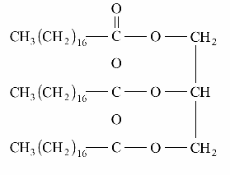
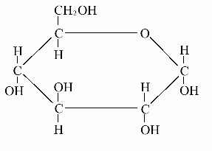
Identify each of these molecules
2
3
1
4
5
6
7
8

Slide 24
1
2
3
4

