Slide 1
Chapter 3: Cell Structure, Function & Transport
Structures, Functions and Organelle Relationships

Slide 2
p.50-50 in textbook
Animal Cell

Slide 3
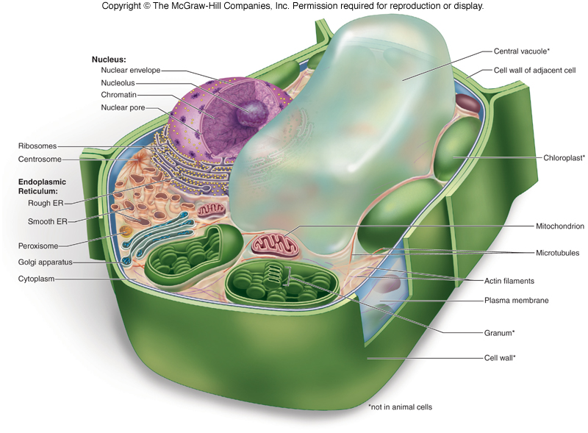
Plant Cell

Slide 4
Cell Membrane & Cell wall
The cell membrane (plasma membrane) creates a cell boundary and helps to regulate the transport of molecules in and out of the cell (in plant & animal cells)
The cell wall is only found in plants and provides a rigid structure for plant cells – it is made of cellulose

Slide 5
The Nucleus
Stores DNA
Controls all cell activities
Nucleolus
site of production and storage of rRNA which join with proteins to form ribosomal subunits
Nuclear Envelope
Nuclear pores for transport of molecules in and out of the nucleus

Slide 6
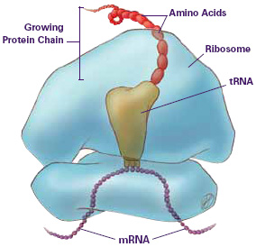
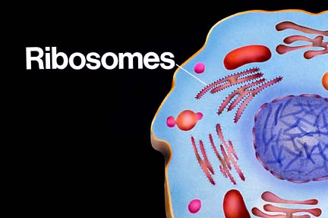
Ribosomes
Site of protein synthesis (where translation occurs)
Can be free-floating or attached the endoplasmic reticulum
Two subunits (large and small)
Subunits consist of rRNA and protein molecules
Polyribosomes
Several ribosomes translating a single mRNA molecule

Slide 7
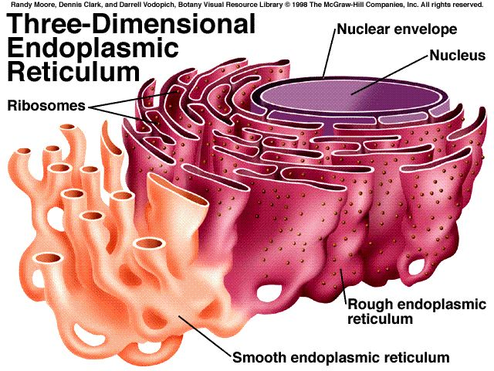
Endoplasmic Reticulum
Consists of membranous channels and saccules
Rough ER
Studded with ribosomes therefore, functions in processing and modification of proteins
Smooth ER
No Ribosomes
Synthesizes phospholipids and steroids
Also involved in detoxification

Slide 8
Golgi Apparatus
The Golgi apparatus processes, assembles, modifies, stores and secretes molecules such as proteins and lipids.
These molecules enter and exit the Golgi Body by vesicles
The Golgi body also produces lysosomes

Slide 9
Lysosomes
Lysosomes contain digestive enzymes that break down or hydrolyze unwanted substances, foreign substances or worn- out parts of cells
Peroxisomes
Also contain enzymes and fuse with vesicles containing toxins
Enzymes deactivate substances by forming hydrogen peroxide (H₂O₂)
H₂O₂ quickly dissociates in the cell into O₂ and H₂O

Slide 10
Vacuoles & Vesicles
Vacuoles and vesicles are membranous sacs that store and/or transport substances.
For example:
Water, Pigments, Toxins, Proteins & Lipids, Foreign molecules, hormones
Vesicles are smaller than vacuoles.
A large central vacuole is found in the plant cell to store water and other nutrients like starch.

Slide 11
Chloroplasts
Only found in plants
Site of photosynthesis where suns energy, along with carbon dioxide and water is converted into oxygen and glucose for the mitochondria to produce cell’s energy ATP.
Structure:
Double-membrane with extensive folding forming the grana, which are stacks of thylakoids
Increased surface area for maximal photosynthesis
Sunlight + CO₂ + H₂O → O₂ + C₆H₁₂O₆

Slide 12
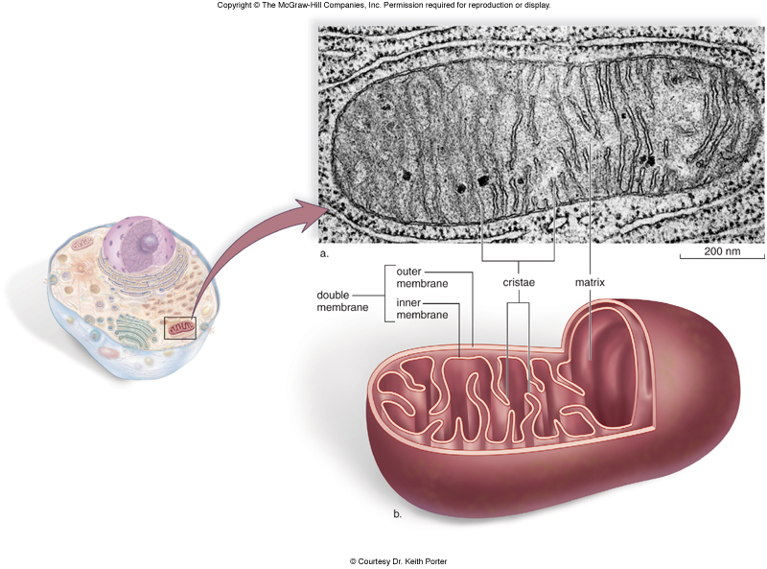
Mitochondria
Found in all animal and plant cells
Site of cellular respiration (cell metabolism) where oxygen and glucose are converted to ATP for cell energy
In animals, Oxygen is from the respiratory system and glucose is from digestion
In plants, oxygen and glucose are produced from the chloroplast during photosynthesis
Structure:
Double-membrane where the inner membrane folds to increase surface area for cellular respiration
The folded membrane is call the cristae and the inner space is the matrix
O₂ + C₆H₁₂O₆ →ATP + CO₂ + H₂O

Slide 13
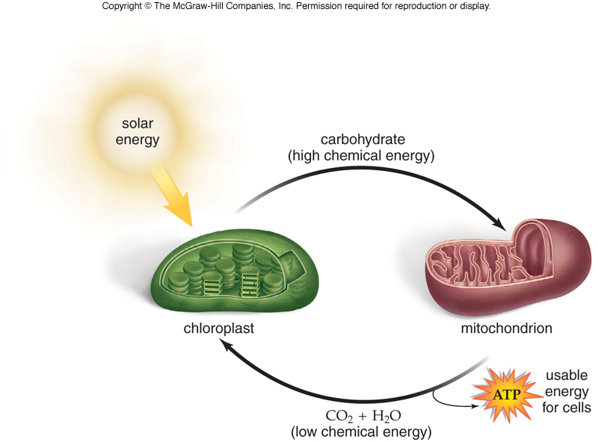
Chloroplasts
Mitochondria
Photosynthesis Cellular Respiration
During photosynthesis, sunlight, CO2, & water are used to make the glucose & O2 that the mitochondria uses for cellular respiration to produce the cell’s ATP supply.
The wastes, CO2 & H2O can be reused in the chloroplast for photosynthesis.
Sunlight + CO₂ + H₂O → O₂ + C₆H₁₂O₆
O₂ + C₆H₁₂O₆ →ATP + CO₂ + H₂O

Slide 14
The Cytoskeleton
Maintains cell shape & assists in movement of the cell and organelles within it
The cytoskeleton is attached to the inside of the cell membrane and vesicles move to and from the cell membrane on the cytoskeleton
Three types of macromolecular fibers
Actin Filaments
Thin protein strands
Intermediate Filaments
Medium protein strands
Microtubules
Thick protein strands
Also forms structure of centrioles, basal bodies, cilia & flagella

Slide 15
Centrioles
Short cylinders with a 9 + 0 pattern of microtubule triplets
Help organize microtubules during animal cell division
Form the structure of basal bodies which also have a 9+0 pattern
Basal Bodies: may be involved in microtubule formation and in the organization of microtubules used to make cilia and flagella

Slide 16
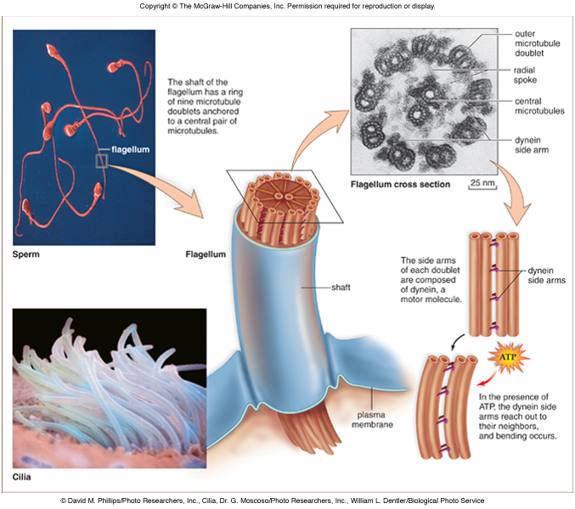
Cilia and Flagella
Hair-like projections that aid in cell movement
cilia are usually shorter than flagella
Cilia move in an oar-like motion whereas flagella move in a whip-like action
The microtubules are arranged in a 9 + 2 pattern

Slide 17
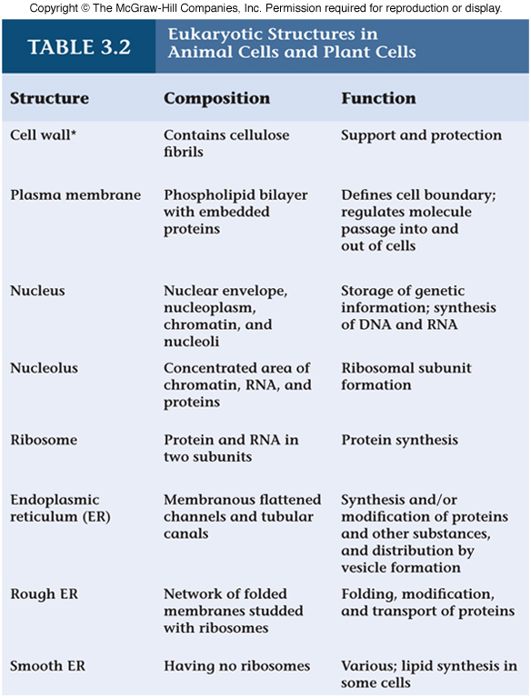

Slide 18
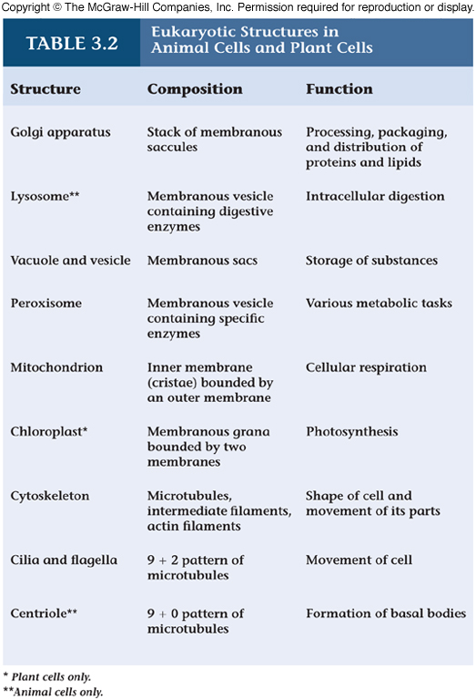

Slide 19
Organelle | Plant or Animal | Function
 | Both | Regulate transport of molecules in/out of cell
 | Plant only | Provides structure to plant cell
 | Both | Jelly-like fluid where organelles & molecules move
 | Both | Transports molecules around the cell
 | Both | Site of protein synthesis; attached to ER
 | Both | Processes, modifies & packages proteins and lipids
 | Both | Studded with ribosomes & site of protein synthesis
 | Both | Site of lipid synthesis & detoxification
 | Plant only | Stores water, starch and other molecules
 | Plant only | Site of photosynthesis – converting sunlight & CO2 to glucose & O2

Slide 20
 | Both | Site of cellular respirations – converting glucose & O2 to H2O, CO2 & ATP energy
 | Both | Controls all cell functions
 | Both | Where rRNA & proteins form the subunits of ribosomes
 | Both | Surrounds DNA and is continuous with the endoplasmic reticulum
 | Animal only | Involved in making spindle fibers during cell division & forms basal bodies
 | Animal only | Fuse with vesicles, vacuoles & old organelles for intercellular digestion
 | Both | Forms the cytoskeleton for anchoring & transporting organelles and forms structure cilia & flagella for cell movement (also forms structure of centrioles & basal bodies)
 | Both | Openings in nucleus that allow molecules like proteins & RNA to exit the nucleus

Slide 21
Organelle ANSWERS | Plant or Animal | Function
Cell membrane | Both | Regulate transport of molecules in/out of cell
Cell wall | Plant only | Provides structure to plant cell
Cytoplasm | Both | Jelly-like fluid where organelles & molecules move
Vacuole & vesicle | Both | Transports molecules around the cell
Ribosome | Both | Site of protein synthesis; attached to ER
Golgi | Both | Processes, modifies & packages proteins and lipids
Rough ER | Both | Studded with ribosomes & site of protein synthesis
Smooth ER | Both | Site of lipid synthesis & detoxification
Central Vacuole | Plant only | Stores water, starch and other molecules
Chloroplast | Plant only | Site of photosynthesis – converting sunlight & CO2 to glucose & O2
Mitochondria | Both | Site of cellular respirations – converting glucose & O2 to H2O, CO2 & ATP energy
Nucleus | Both | Controls all cell functions
Nucleolus | Both | Where rRNA & proteins form the subunits of ribosomes
Nuclear membrane | Both | Surrounds DNA and is continuous with the endoplasmic reticulum
Centrioles | Animal only | Involved in making spindle fibers during cell division & forms basal bodies
Lysosomes | Animal only | Fuse with vesicles, vacuoles & old organelles for intercellular digestion
Microtubules | Both | Forms the cytoskeleton for anchoring & transporting organelles and forms structure cilia & flagella for cell movement (also forms structure of centrioles & basal bodies)
Nuclear pores | Both | Openings in nucleus that allow molecules like proteins & RNA to exit the nucleus

Slide 22
Section 1.1: Cell Organelles
Organelle | Function
 | O₂ + C₆H₁₂O₆ → CO₂ + H₂O + ATP
 | CO₂ + H₂O + ATP → O₂ + C₆H₁₂O₆
 | Contains hydrolytic enzymes and fuses with vesicles/vacuoles to digest contents
 | Produces steroids and detoxifies
 | Stores genetic information which determines cell functions
 | rRNA & proteins form the subunits of ribosomes here
 | Produces lysosomes

Slide 23
Organelle | Function
 | Openings allow molecules to enter and exit the nucleus
 | Made of cellulose and gives structure to plant
 | High surface area for producing proteins
 | Transports small molecules throughout the cell
 | Involved in cell division and forms basal bodies
 | High surface area for cellular respiration
 | Packages and assembles proteins and lipids

Slide 24
Fill in the middle box with an explanation that relate the two organelles
Ribosomes
Golgi Body
nucleolus
ribosome
lysosome
Bacterium in vacuole
microtubules
centrioles

Slide 25
Fill in the middle box with an explanation that related the two organelles
1. | The cells of the adrenal glands would contain high numbers of which organelle and why?
2. | Describe (briefly) the functions of the cell membrane.
3. | How do the mitochondria and chloroplast relate?
4. | How do microtubules relate to the cytoskeleton, cilia and flagella?
5. | What’s the difference between the Smooth ER and the Rough ER?

Slide 28
Chapter 3 continued: Cell Membrane Transport
Elluminate Session 2: July 5, 2012

Slide 29
Cell Membrane Structure
Phospholipid bilayer
Proteins
Carrier
Channel
Cell recognition
Receptor
Enzymatic
Carbohydrate chains
Glycolipid
glycoprotein
Cholesterol

Slide 30
channel
protein
Phospholipid
bilayer
Carrier
protein
Enzymatic
protein
Receptor
protein
glycoprotein
glycolipid
cholesterol

Slide 31
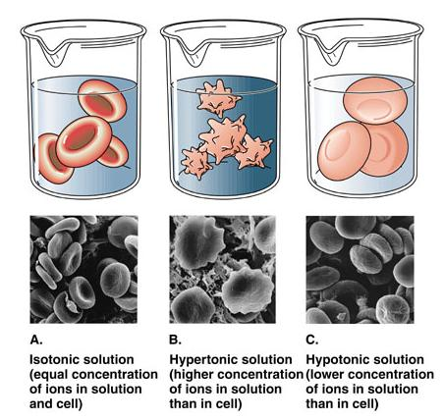
Passive Transport
Diffusion
Molecules go from high to low concentration
Small lipid- soluble molecules
Osmosis
Diffusion of water
Isotonic
Hypotonic
Hypertonic

Slide 32
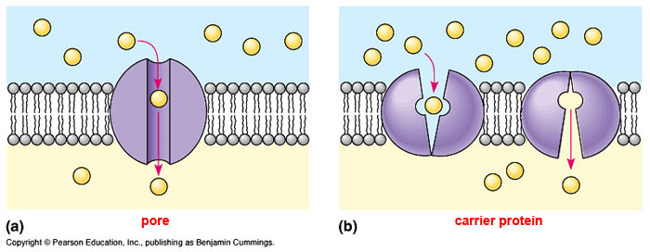
Passive Transport
Facilitated Transport
Molecules move from high to low conentration
Uses protein channel or carrier
Small molecules and ions\
Ex. glucose

Slide 34
Active Transport
Active Transport
Molecules move from low to high concentration
Uses protein carrier
Small molecules and ions\
Ex. Sodium-potassium pump

Slide 35
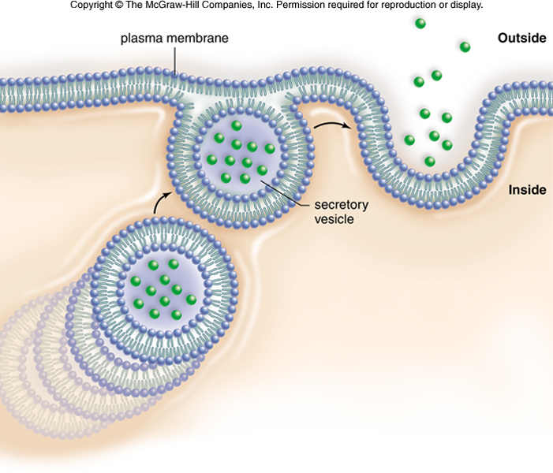
Active Transport
Exocytosis
Requires ATP due to the movement of vesicles
A vesicle from inside the cell fuses with the cell membrane and the contents are released from cell
Vesicle plasma membrane
becomes a part of the cell
membrane
Ex. Exocytosis of insulin

Slide 36
Active Transport
Endocytosis
Requires ATP due to the movement of vesicles
A vesicle forms when a molecule or substance is entering into the cell
Vesicle forms around the molecule engulfing it

Slide 37
Active Transport
3 Types
Phagocytosis = large molecules enter

Slide 38
Pinocytosis = small molecules or liquids enter

Slide 39
Receptor-mediated endocytosis = receptor attaches causing invagination of cell membrane and vesicle or vacuole forms around the substance to bring it into cell.

Slide 40
Summary of Membrane Transport

Slide 41
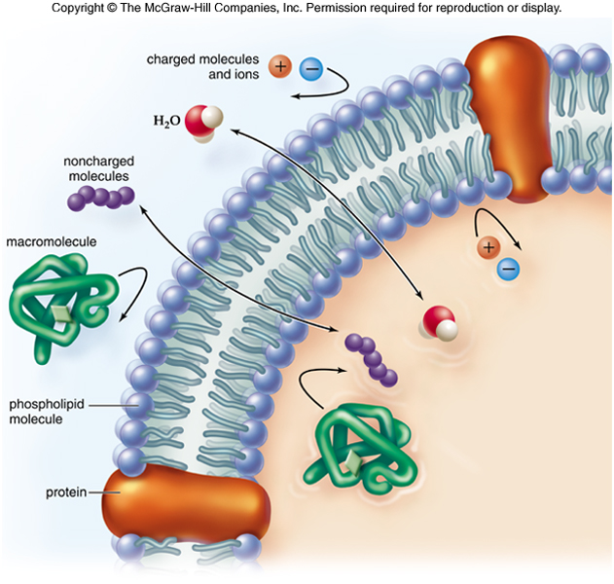

Slide 42
exocytosis
pinocytosis
Active transport
diffusion
Receptor-mediated
Endocytosis
osmosis
Facilitated transport

Slide 43
Passive Transport vs. Active Transport
High to low concentration
Low to high concentration
No ATP required
ATP required
lipid-soluble molecule
Polar molecule
Phospholipid bilayer
macromolecules
Small molecule
Vesicles involved
diffusion
Ex. O2 & CO2
macromolecules
osmosis
Ex. water
Receptor used
Isotonic solution
Endocytosis & Exocytosis
Hypertonic solution
Ex. bacteria
Hypotonic solution
Facilitated diffusion
Carrier proteins
Ex. glucose
Ex. Na+/K+ pump
Channel proteins
Carrier proteins

Slide 44
Structure/Process | Function
Receptor Protein | Molecule attaches to it and causes some change in the cell
Carbohydrate Chain Glycolipid (in image) & Glyoprotein | Involved in cell recognition
Carrier Protein Facilitated Transport | Glucose is transported by this structure in the cell membrane
Phospholipid bilayer Diffusion | Oxygen & Carbon Dioxide travels through the cell membrane by this process
Phospholipid bilayer Diffusion | When small molecules move from high to low concentration through the plasma membrane
Enzymatic protein | When a molecule attaches to it, it catalyzes a reaction and products are formed
Phospholipids Cell membrane Plasma membranes | The tails are hydrophobic/non-polar and the heads are hydrophilic/polar

Slide 45
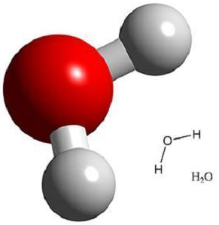
Structure/Process | Function
Channel protein Facilitated Transport | Transports molecules through the cell membrane via an open pore
Exocytosis | Uses ATP to transport molecule in vesicles out of the cell
Endocytosis Phagocytosis | Large molecule enters the cell and a vacuole forms around it
Glycolipid | Carbohydrate chain attached to a lipid on the cell membrane
Glycoprotein | Carbohydrate chain attached to a protein on the cell membrane
Osmosis | Water travels through the membrane by this process
Hypotonic & Hypertonic | The 2 environments where the net change in water is not zero (either water gained or lost)

