Slide 1
chapter 5: Enzymes

Slide 2
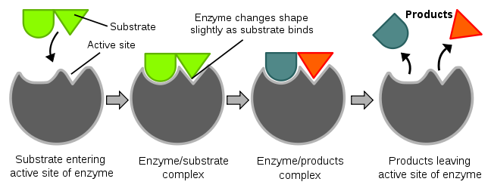
Structure & Function of Enzymes
Enzymes are made of proteins
It catalyzes reaction by speeding them up and lowering the energy it take to have a reaction proceed = lowers Energy of Activation
Enzymes can help build up molecules (condensation synthesis reactions) OR help breakdown molecules (hydrolysis/digestion)
Substrates are the reactants and enter the enzymes active site.
The enzyme-substrate complex (ES complex) allows a reaction to occur and produce the product(s)

Slide 3
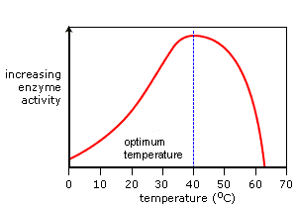
Factors that affect enzyme activity
Temperature
Optimal temperature for enzymes in human bodies is at 37.5 – 40⁰C where the enzymes and substrates collide at a high speed resulting in the maximal ES complexes for the optimal reaction rate.
Temperatures greater than 40⁰C can increase kinetic energy and increase collisions between enzymes and substrates; however, the reaction rate lowers as the enzymes denature and no ES complex can form.
Temperatures lower than 400C result in lower kinetic energy and cause molecules to move more slowly resulting in fewer collisions between enzymes and substrates; therefore a lowered number of ES complexes and a lower reaction rate

Slide 4
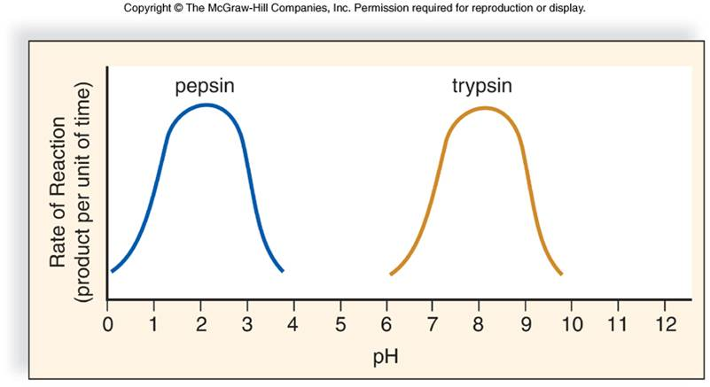
pH
Every enzyme works at an optimal pH.
The optimal pH varies for different areas of the body
For example, a pH of 2 in the stomach is optimal for the gastric enzyme pepsin and a pH of 7 is optimal for salivary enzyme amylase in the mouth and a pH of 8 is optimal for trypsin in the small intestine.
If pH decreases or increases from optimal, the enzymes denature which results in fewer to no ES complexes forming and therefore a lowered reaction rate.

Slide 5
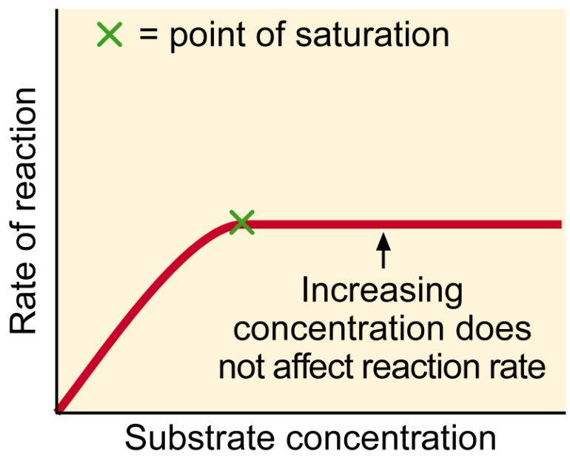
Enzyme Concentration
As enzyme concentration increases, this increases collisions between enzymes and substrates resulting in increased ES complexes and an increased reaction rate
Substrate Concentration
As substrate concentration increases, there is an increased number of ES complexes due to increased collisions; hoever, the reactionrate maximises at the point where all enzymes are saturated with substrate
An increase in substrate does not increase the reaction rate
If more enzymes were added the reaction rate would again increase

Slide 6
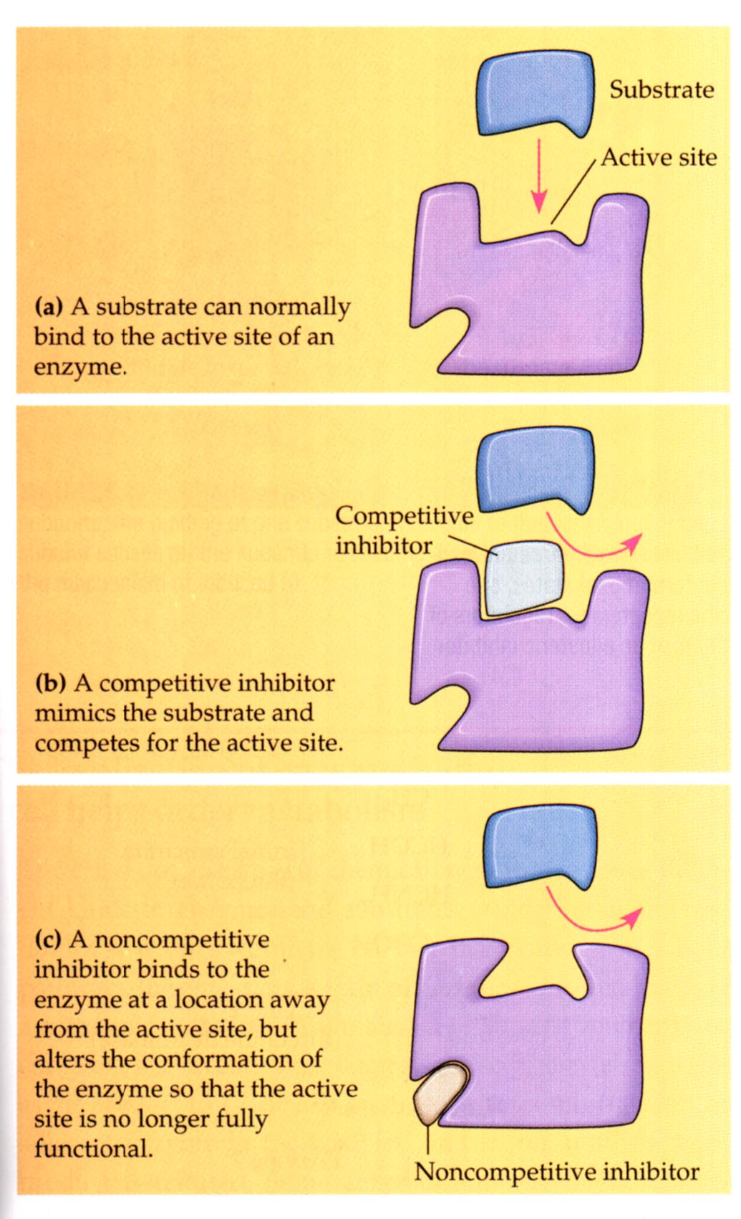
Inhibitors
Competitive Inhibitors
This inhibitor attaches to the active site and blocks the substrate from attaching
No ES complex forms therefore there is a lowered or zero reaction rate
Non-competitive Inhibitors
This inhibitor attaches at the other site or allosteric site on the enzyme and causes the active site to change
The substrate cannot attach; therefore no ES complex forms and there is a lowered or zero reaction rate

Slide 7
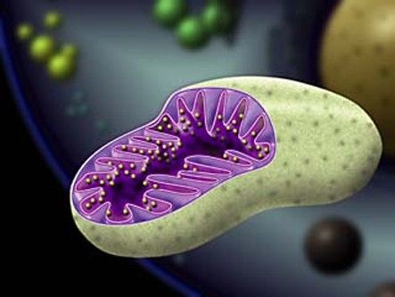
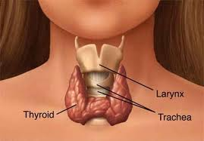
Metabolism
Cellular Respiration
This is a metabolic reaction that occurs in the mitochondria of all cells
Each step of the reaction requires specific enzymes
The reaction is :
O2 + C6H12O6 → CO2 + H2O + ATP
This reaction is regulated by the hormone thyroxin which is produced in the thyroid gland (in your neck)

Slide 8
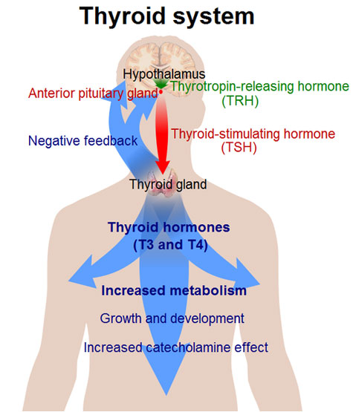
Thyroxin Pathway
The hypothalamus controls the release of thyroxin from the thyroid gland by TSH

Slide 9
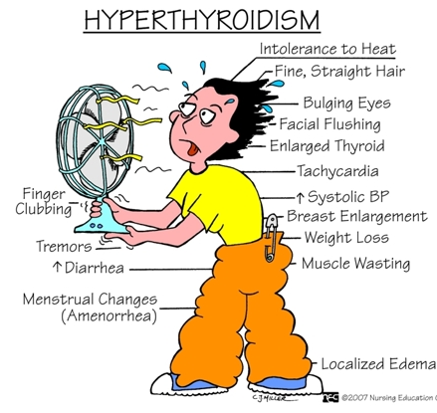
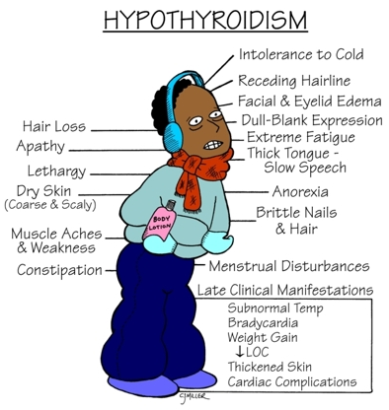
Thyroid Conditions
Hypothyroidism is a low thyroxin Hyperthyroidism is a high thyroxin

Slide 10
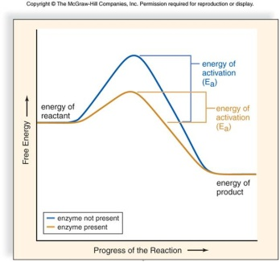

Slide 13
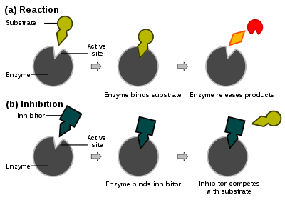

Slide 14
