Slide 1
Chapter 9: digestion

Slide 2
ABSORPTION AMYLASE
BILE
COLON DEFECATION DIGESTION DUODENUM EPIGLOTTIS ESOPHAGUS FECES
GLANDS
HCL
HYDROLYSIS LIPASE
LIVER
MALTASE
MOUTH NEUTRALIZE NUCLEASE NUCLEOSIDASE PANCREAS PEPSIN PEPTIDASE PERISTALSIS PHARYNX RECTUM
SALIVA SPHINCTER STOMACH TRYPSIN

Slide 3
Digestive Structures and Functions
Digestion is the chemical breakdown of food by enzymes.
Physical digestion is mixing, churning and emulsifying of food
Digestion involves hydrolytic enzymes which work at specific pH’s
Any molecules not digested and not absorbed are considered waste and are excreted via the rectum.

Slide 4
Mouth
Teeth for tearing, chewing & grinding the food
Incisors for biting & tearing
Canines for tearing
Premolars and molars for grinding & chewing
Hard palate at front roof of mouth
Soft palate at back roof of mouth
When swallowing the tongue pushes up the soft palate to close off the nasal cavity so food goes down towards esophagus
Uvula may be involved in creating a good seal for nasal cavity during swallowing
Tonsils involved in immunity
Tongue for mixing food with saliva

Slide 5
Salivary Glands & Swallowing
Salivary glands secrete water, mucus, and salivary amylase
Salivary amylase digests starch to maltose by hydrolysis
Starch + H2O maltose
Salivary amylase
Swallowing involves the soft palate moving up to block nasopharynx (to nasal cavity) & the epiglottis moving down to block the opening to the lungs (the glottis)

Slide 7
Stomach
Smooth muscle causes peristalsis down the esophagus and it continues in the stomach to churn food with acid
Food enters the stomach via the cardiac sphincter
Gastric juices are secreted from gastric glands when the GASTRIN hormone stimulates them.
Mucus secreted protects the lining of the stomach
Gastric glands secrete HCl to make a pH of 2, water, pepsinogen
Bacteria can be killed by stomach acid
Pepsinogen is converted to pepsin in the presence of HCl.
Pepsin digests proteins to peptides
Proteins + H2O peptides
pepsin

Slide 8
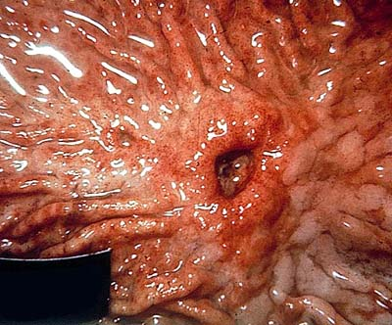

Slide 9
Small Intestine
3 parts = duodenum, jejunum, ileum
Acid chyme enters duodenum via the pyloric sphincter
Pancreatic juices from pancreas enter via pancreatic duct
Bile from Liver and gall bladder enter via bile duct
Sodium bicarbonate (NaHCO3) from pancreas neutralizes acid chyme to a pH = 8.5
Pancreatic enzymes and intestinal enzymes from the duodenum complete digestion of molecules; ie. Starch, protein, lipids, nucleic acids
Absorption of nutrients occurs along small intestine which has a high surface area due to villi
Glucose, amino acids, phosphate group, pentose sugar, nitrogenous base enter blood capillary
Fatty acids and glycerol reform into a lipoprotein and are absorbed into the lacteal

Slide 10
Digestive Reactions in Small Intestine
Starch + H2O Maltose
Pancreatic
Enzyme
Pancreatic amylase
Maltose + H2O Glucose
maltase
S.I. Enzyme
Proteins + H2O Peptides
trypsin
Pancreatic
Enzyme
Peptides + H2O Amino Acids
peptidase
S.I. Enzyme
Lipids emulsified by bile Fat Droplets
Liver & Gall Bladder
Lipids + H2O Fatty Acids & Glycerol
Lipase
Pancreatic
Enzyme
Nucleic Acids + H2O Nucleotides
Pancreatic
Enzyme
Nuclease
Nucleotides+ H2O Phosphate + Sugar + N. Base
Nucleosidase
S.I. Enzyme

Slide 11
Digestive Reactions in Small Intestine
+ H2O Maltose
Pancreatic
Enzyme
Pancreatic amylase
+ H2O
maltase
S.I. Enzyme
Proteins + H2O Peptides
Pancreatic
Enzyme
+ H2O Amino Acids
peptidase
S.I. Enzyme
Lipids Fat Droplets
Liver & Gall Bladder
Lipids + H2O
Pancreatic
Enzyme
Lipase
Nucleic Acids + H2O Nucleotides
Pancreatic
Enzyme
Nucleotides+ H2O
Nucleosidase
S.I. Enzyme

Slide 12
Large Intestine = Colon
Site of water absorption
Houses E.Coli for continued digestion and production of vitamins
Feces solidifies as water is absorbed
Indigestible fibre and other molecules exit body after the defecation reflex in the rectum

Slide 13
Defecation
Internal sphincters are involuntary
External sphincters are voluntary

Slide 14
Liver
Detoxifies blood
Regulates cholesterol
Stores glucose as glycogen
Stores vitamins and iron
Produces plasma proteins
Breaks down old red blood cells (hemoglobin)
Breaks down amino acids = produces urea
Produces bile from breakdown of hemoglobin
Pancreas
Produces insulin and glucagon to regulate blood glucose
Produces digestive enzymes and NaHCO3 to neutralize acid chyme

Slide 15
Hepatic Portal Vein : carries absorbed nutrients from digestive tract to liver for processing and joining general circulation to rest of body.

Slide 16
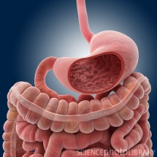
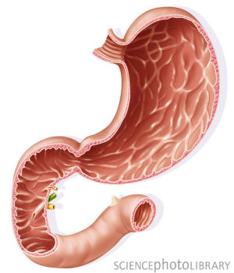
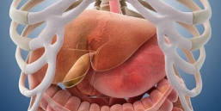
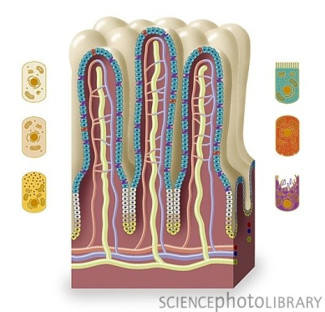
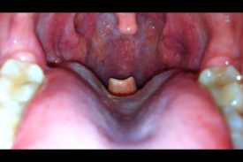
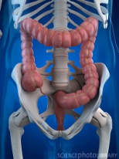
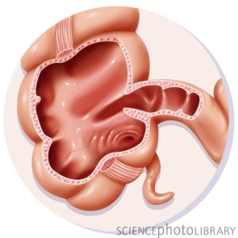
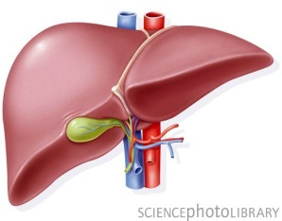
Match Image | Structure | Function
 |  | Contains rugae to expand and hold food
 |  | Detoxifies blood
 |  | Brush border to increase surface area
 |  | Closes opening to larynx when swallowing
 |  | Site of water absorption
 |  | May function in immunity but no real known function
 |  | Feces stored and site of defecation
 |  | Stores bile produced by liver
 |  | Secretes a substance responsible for neutralizing acid chyme

Slide 17
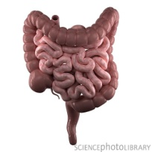
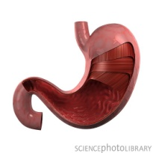
Match Image | Structure | Function
 |  | Secretes hormones that regulate blood sugar
 |  | Produces urea and regulates cholesterol
 |  | Site of complete digestion of food and absorption of molecules
 |  | pH = 2
 |  | Mucus protects lining
 |  | Blood high in nutrients carried to liver through this
 |  | Where small intestine and large intestine join
 |  | Contains the lacteal for fat absorption
 |  | When swallowing, it moves up to guide food into esphagus

